Slide 1
NUCLEAR AND QUANTUM PHYSICS

Slide 2
E Nuclear and Quantum Physics
E.1 Structure of The Atom
E.2 Quantum Physics
E.3 Radioactive Decay
E.4 Fission
E.5 Fusion and Stars

Slide 3
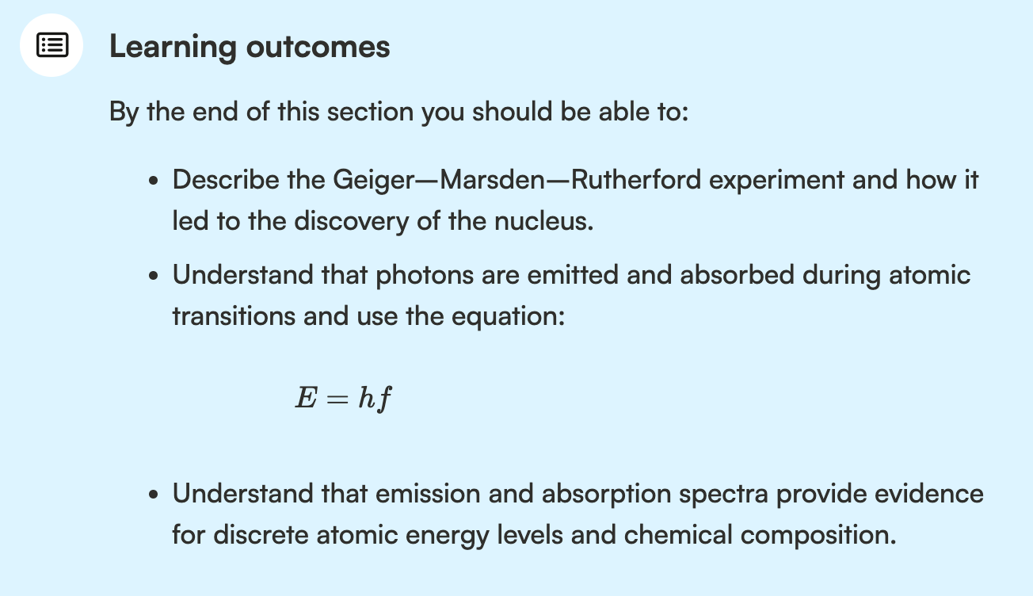
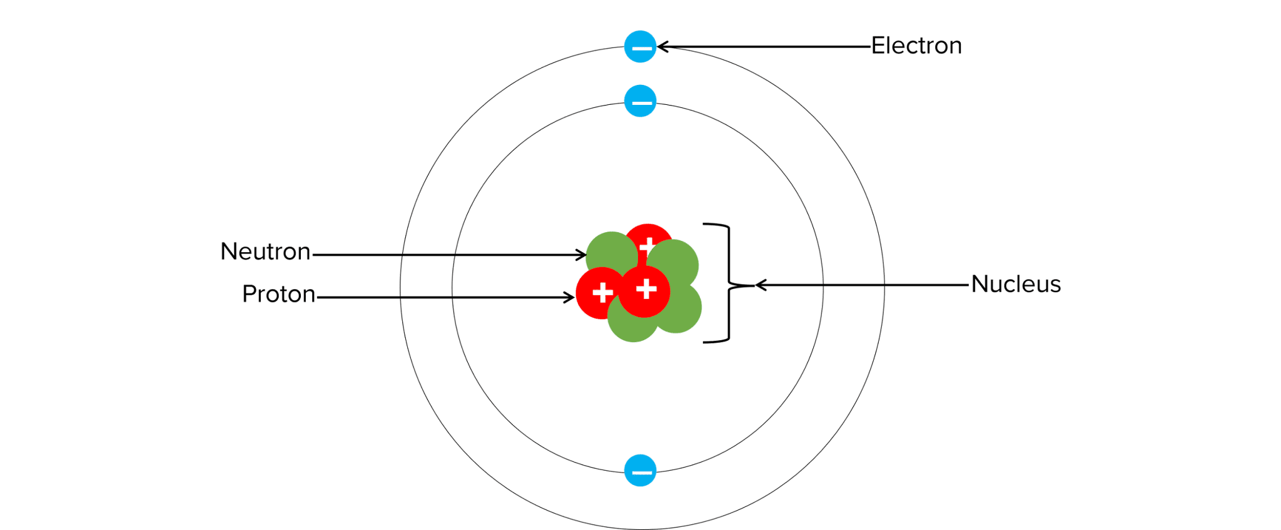
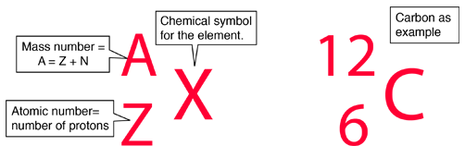
Structure of The Atom
Unified atomic mass
Nuclei
Nucleus
Nucleon
Atomic number
Nucleon number
Neutron
Electron
Proton

Slide 4
How do we know what the atom looks like?
What is inside the atom?
What is light?
What type of light comes from the sun? From a lamp? Is there a difference and why?

Slide 5
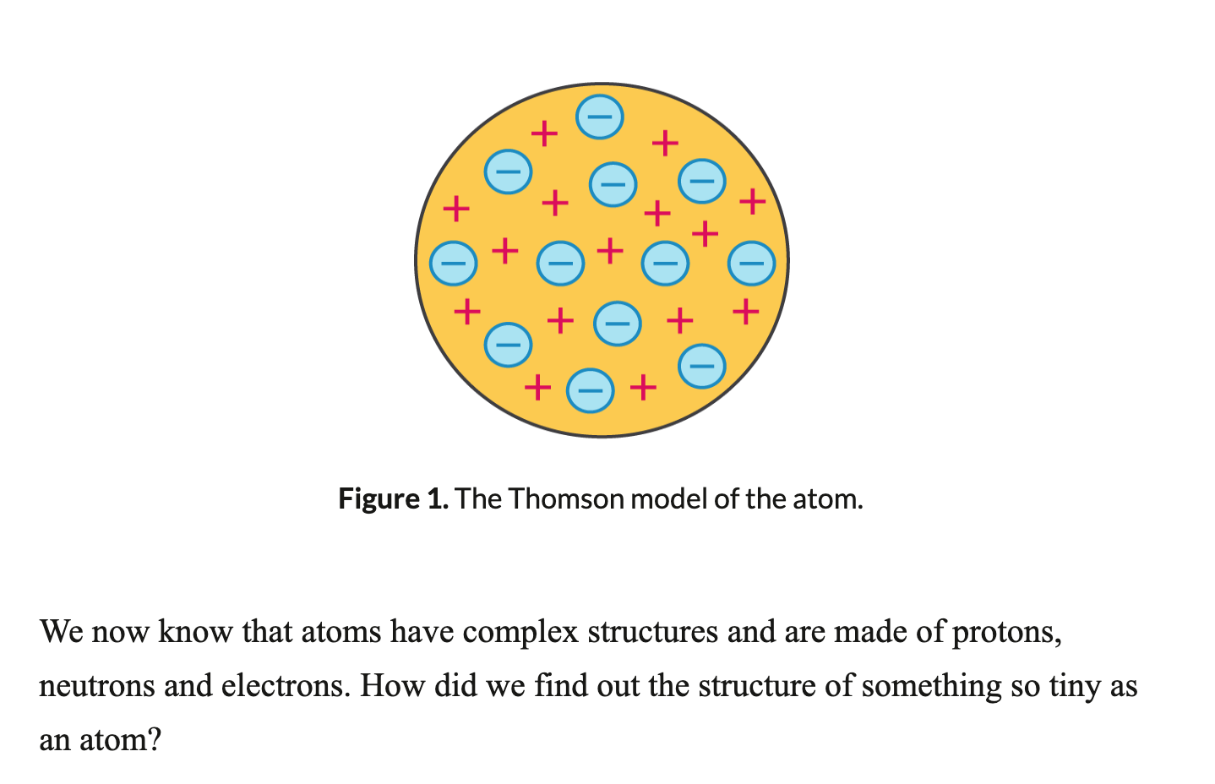
Thomson model

Slide 6
Structure of The Atom
Unified atomic mass
Nuclei
Nucleus
Nucleon
Atomic number
Nucleon number
Neutron
Electron
Proton

Slide 7
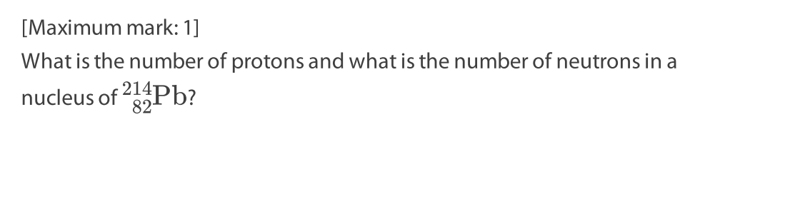
Structure of The Atom
How many protons, neutrons and electrons does S-35 have?

Slide 8

Unified Atomic Mass
Quantity | Symbol | Unit
Mass | m
This is roughly the mass of a proton or a neutron.

Slide 9
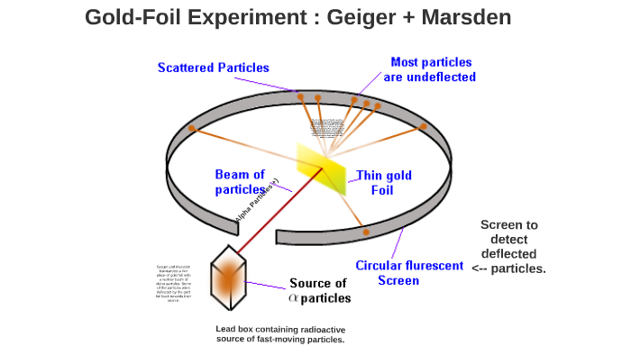
Geiger and Marsden Experiment
Rutherford experiment/Gold Foil Experiment

Slide 10
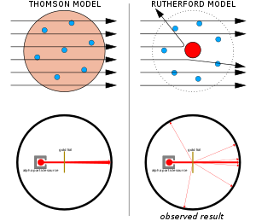
Geiger and Marsden
Rutherford experiment/Gold Foil Experiment

Slide 11
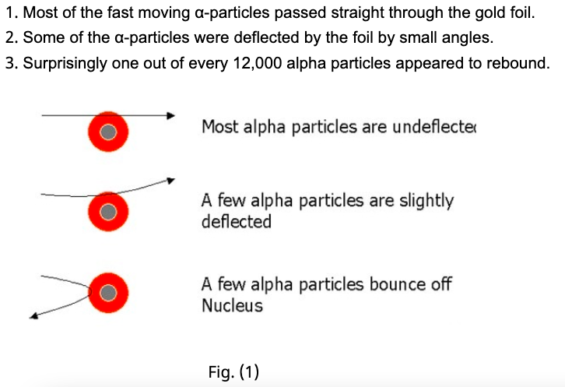
Observations of Rutherford’s Scattering

Slide 12
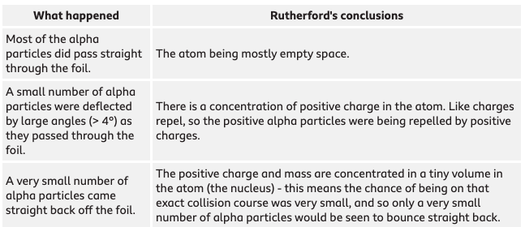
Conclusions

Slide 13
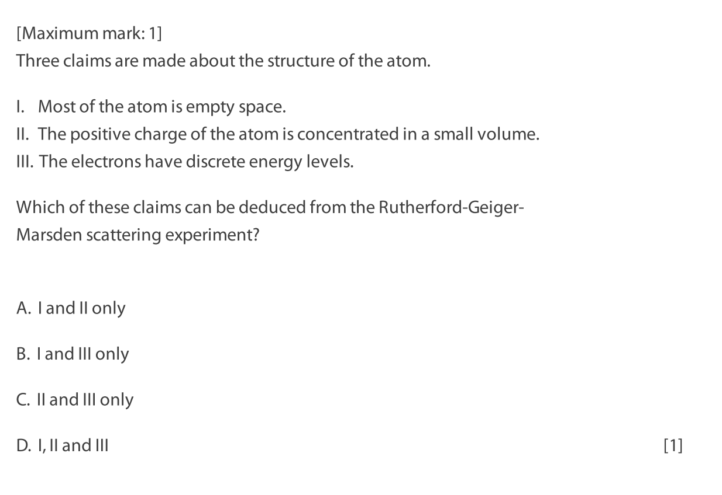

Slide 14
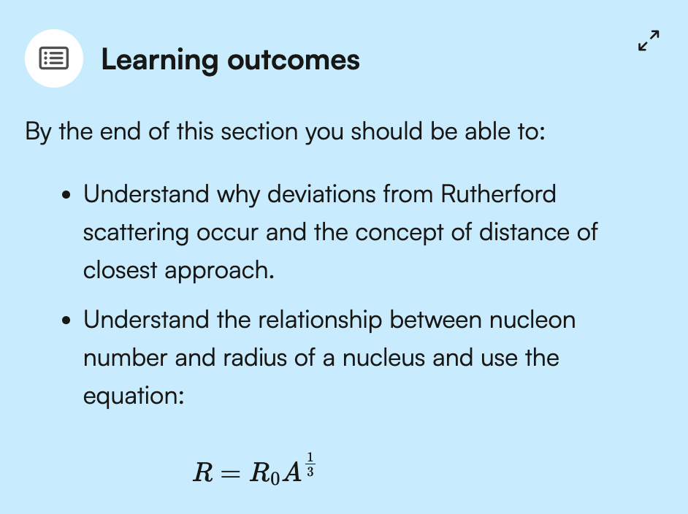
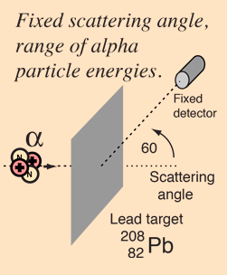
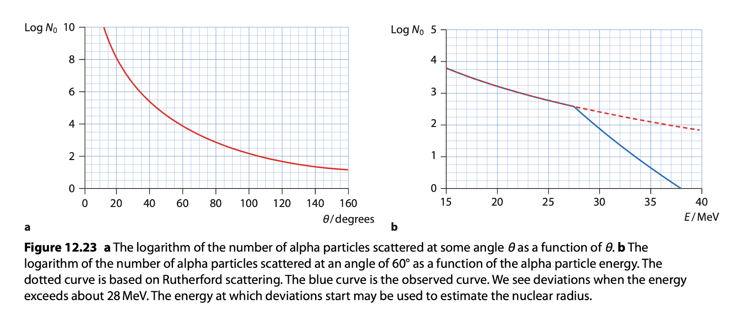

Deviations from Rutherford Scattering

Slide 15
Deviations from Rutherford Scattering (klik!)

Slide 16
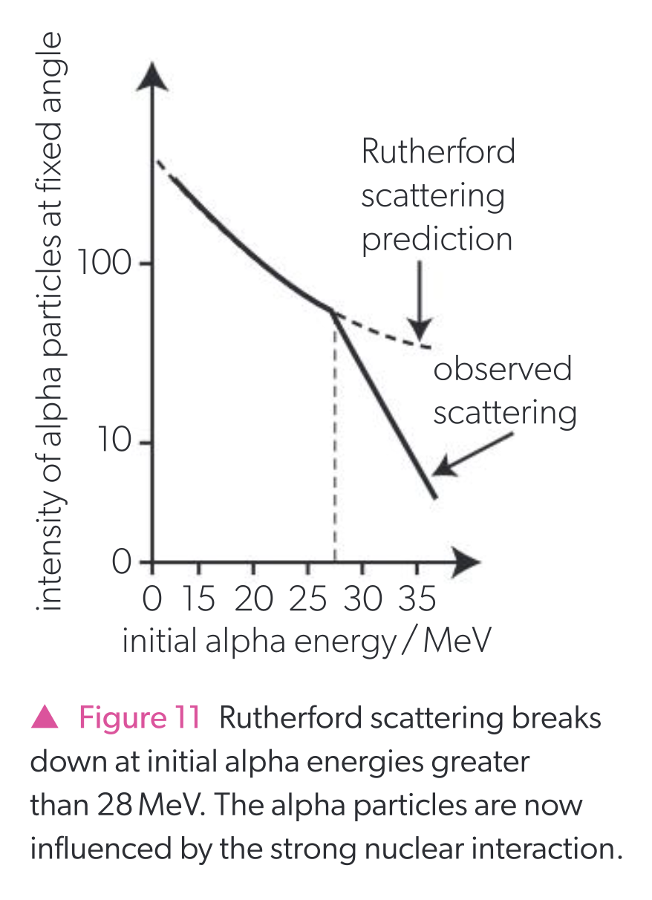
Deviations from Rutherford Scattering

Slide 17
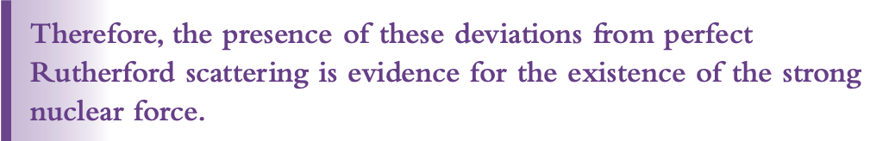
Deviations from Rutherford Scattering

Slide 18
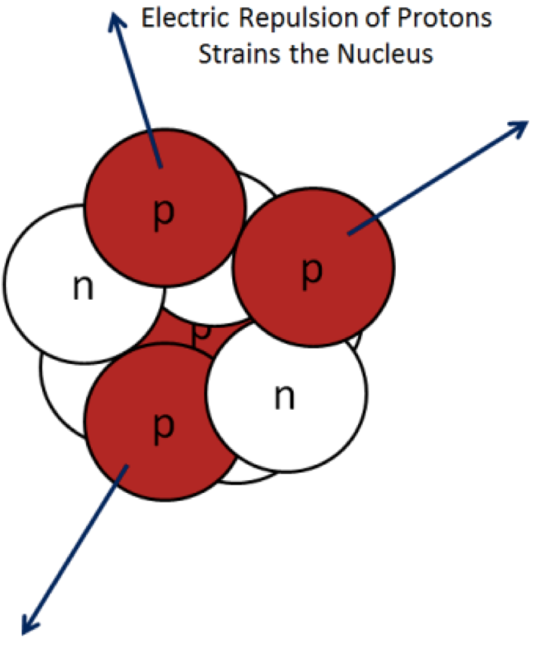
Protons together?
According to Coulomb’s law, protons repel each other.
How is it possible that protons stay closely packed together in the nucleus of an atom?

Slide 19
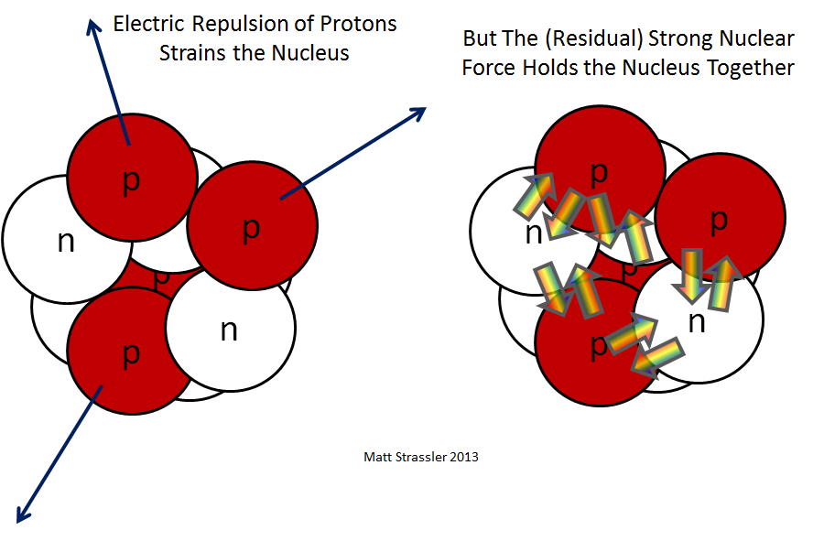
Attraction between the nucleons Strong Nuclear Force

Slide 20


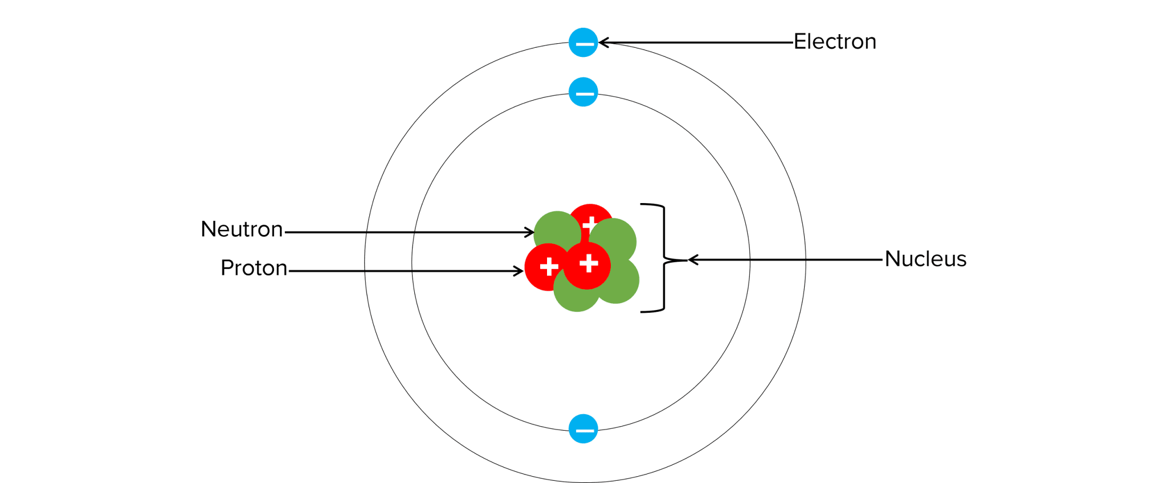

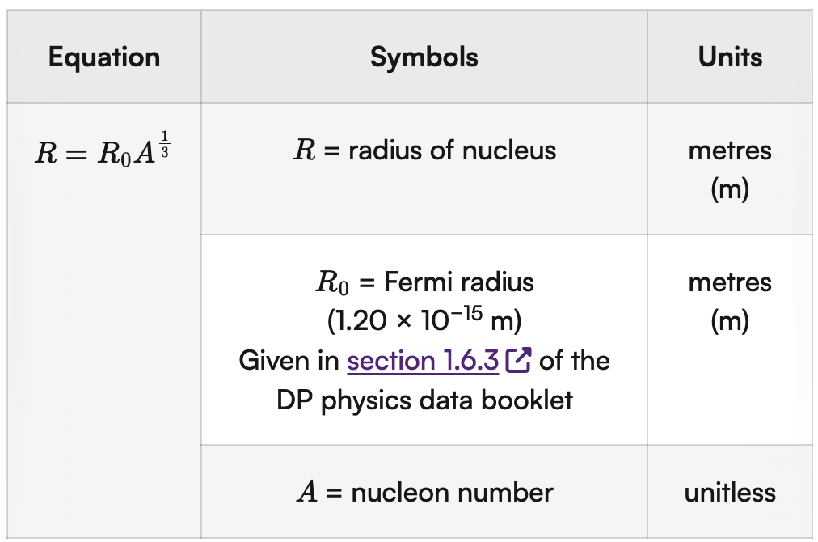
Radius of a Nucleus

Slide 21
Density of a Nucleus
Derive a formula for the density of a nucleus in terms of R0 and mass of nucleon.

Slide 22
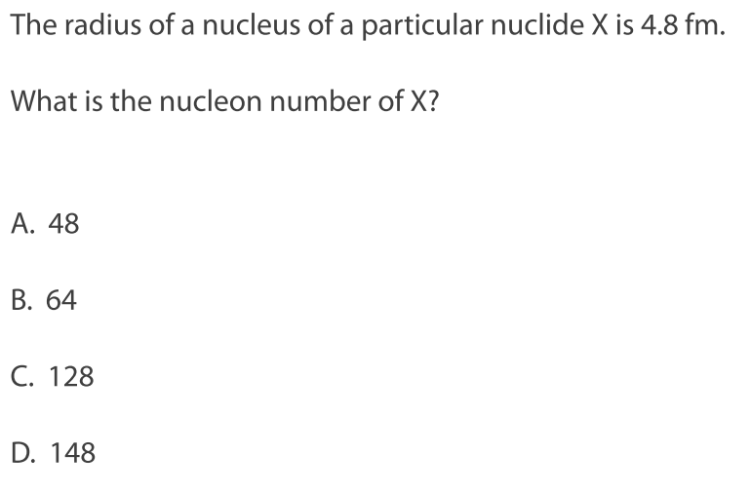
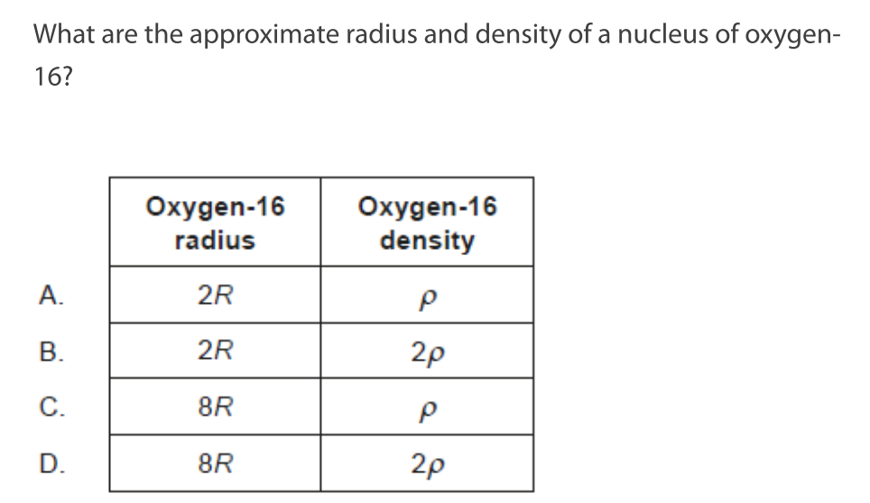
Derive a formula for the density of a nucleus in terms of R0 and mass of nucleon.

Slide 23
Deviations from Rutherford Scattering

Slide 24
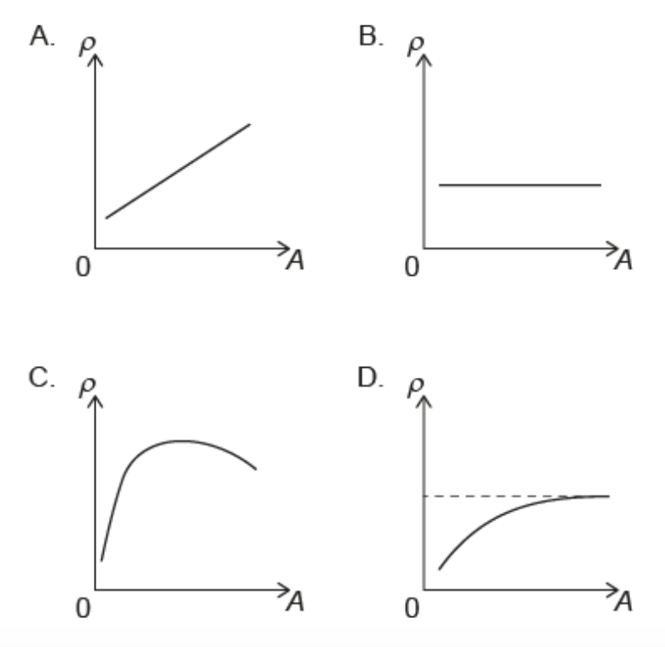

Slide 25
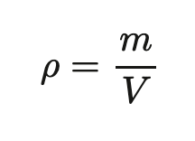
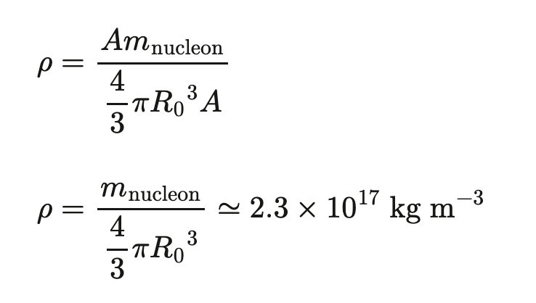

Slide 26
Deviations from Rutherford Scattering

Slide 27
Deviations from Rutherford Scattering

Slide 28
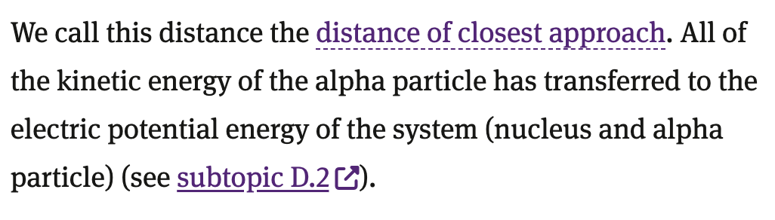
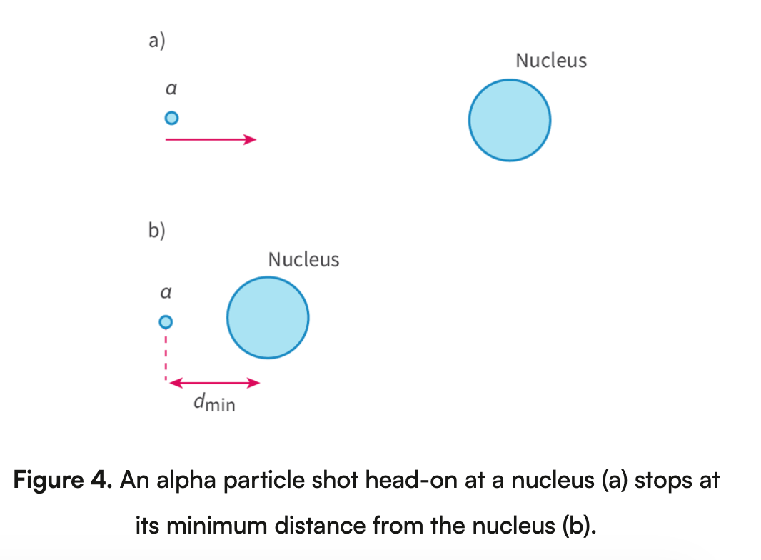
How would you calculate the distance of closest approach?
What do you equal to eachother?

Slide 29
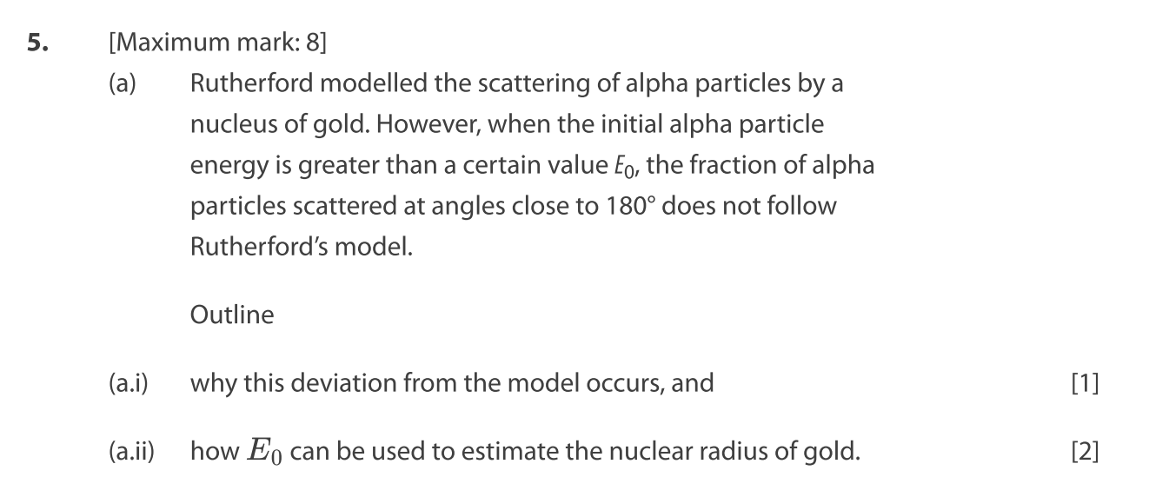
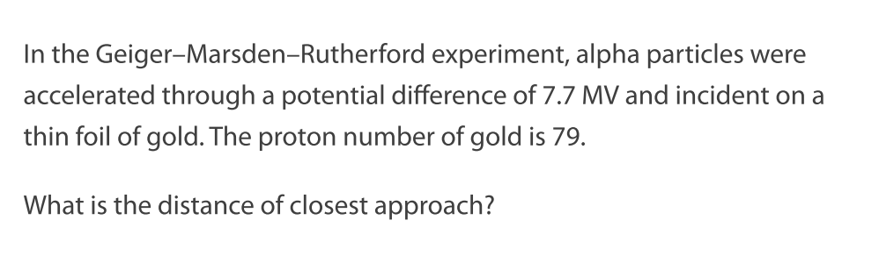

Slide 30
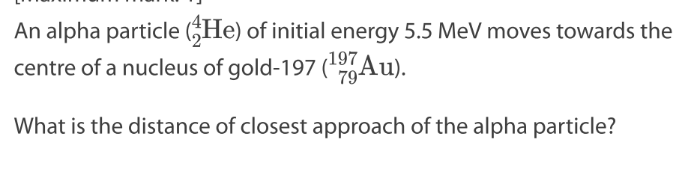

Slide 31


Slide 32
Lesson plan
E.1.3: Spectroscopy (30 min)
E.1.3: Energy levels (40 min)
E.1 HL Only: Quantisation of bohr energy levels (if time)
Recap lesson and next lesson (5 min)

Slide 33
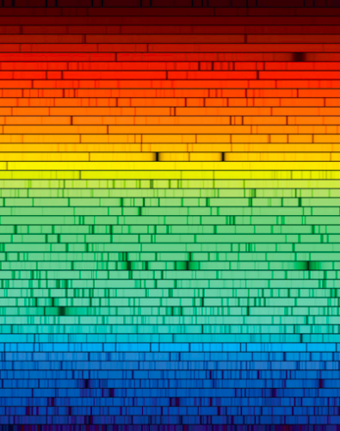
What is light?

Slide 34
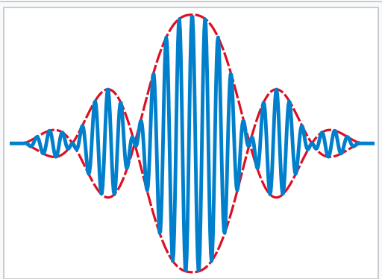
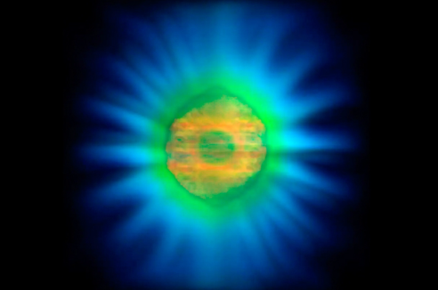
Electromagnetic Radiation

Slide 35
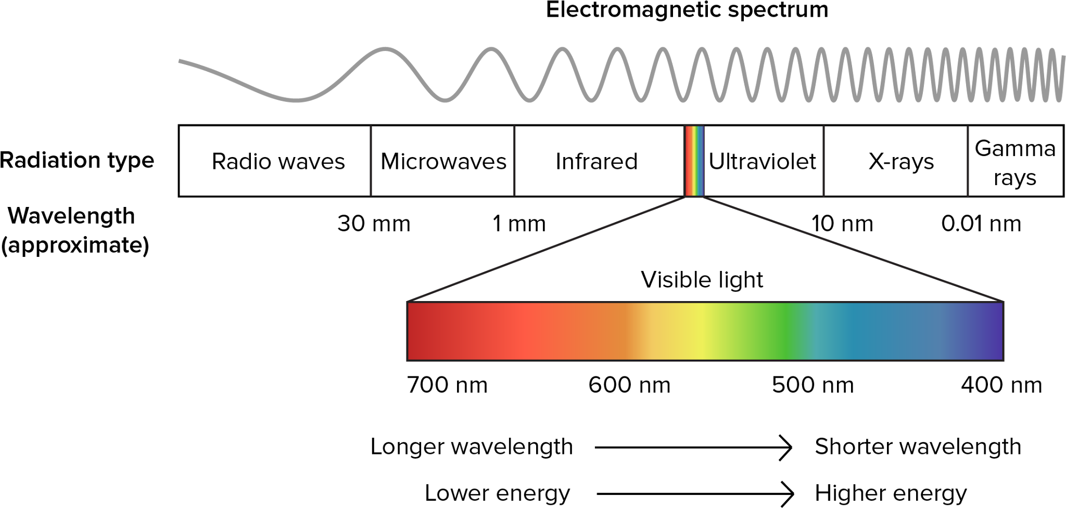

Electromagnetic Radiation

Slide 36

What happens when light interacts with a substance?

Slide 37
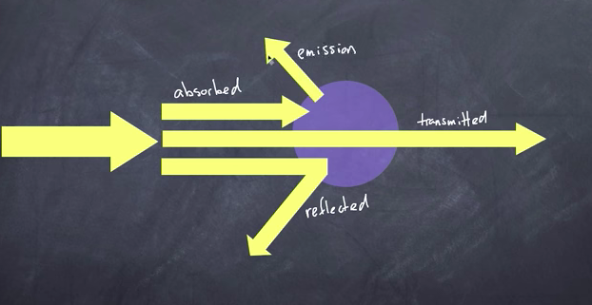
Interactions with light

Slide 38

When do we see something?

Slide 39

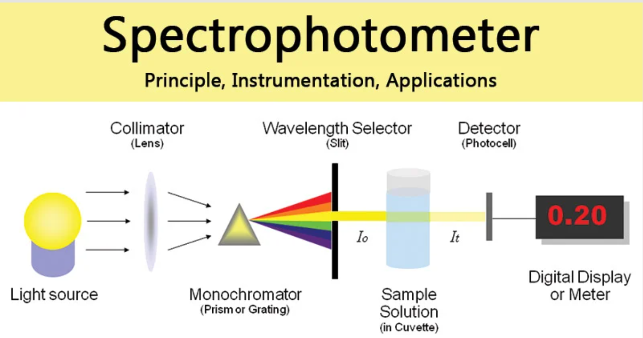
Atomic, Nuclear and Particle Physics
Why do the different colors happen for the different metals? (klik!)
What is spectroscopy?
What is the use of a spectrometer?
What are emission and absorption lines?
Spectrometer

Slide 40
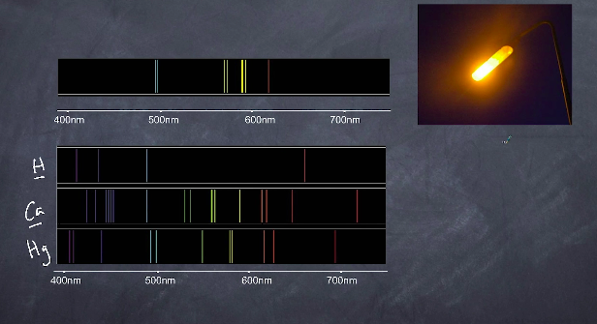
Finger Prints (klik!)

Slide 41
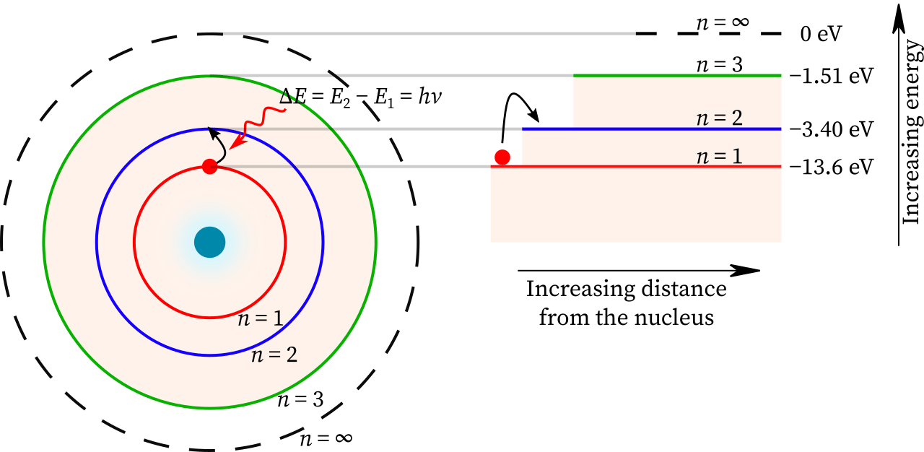

Slide 42
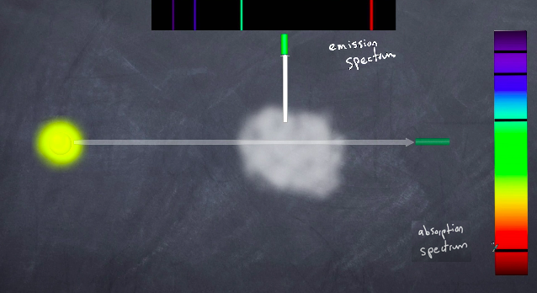
Emission and Absorption Spectrums

Slide 43
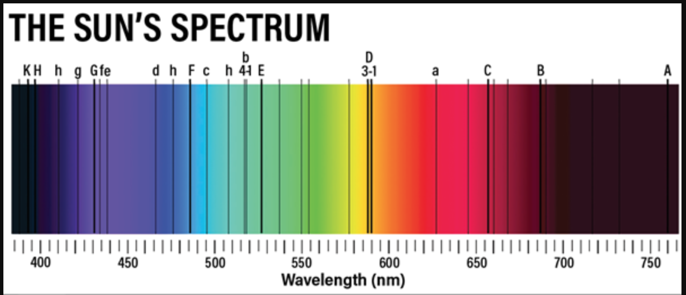
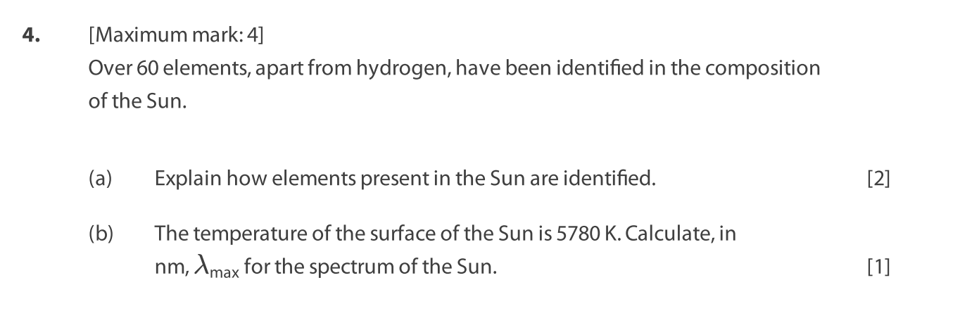
More: E.1 SL paper questions 9, 13

Slide 44
Structure of The Atom
Unified atomic mass
Nuclei
Nucleus
Nucleon
Atomic number
Nucleon number
Neutron
Electron
Proton

Slide 45
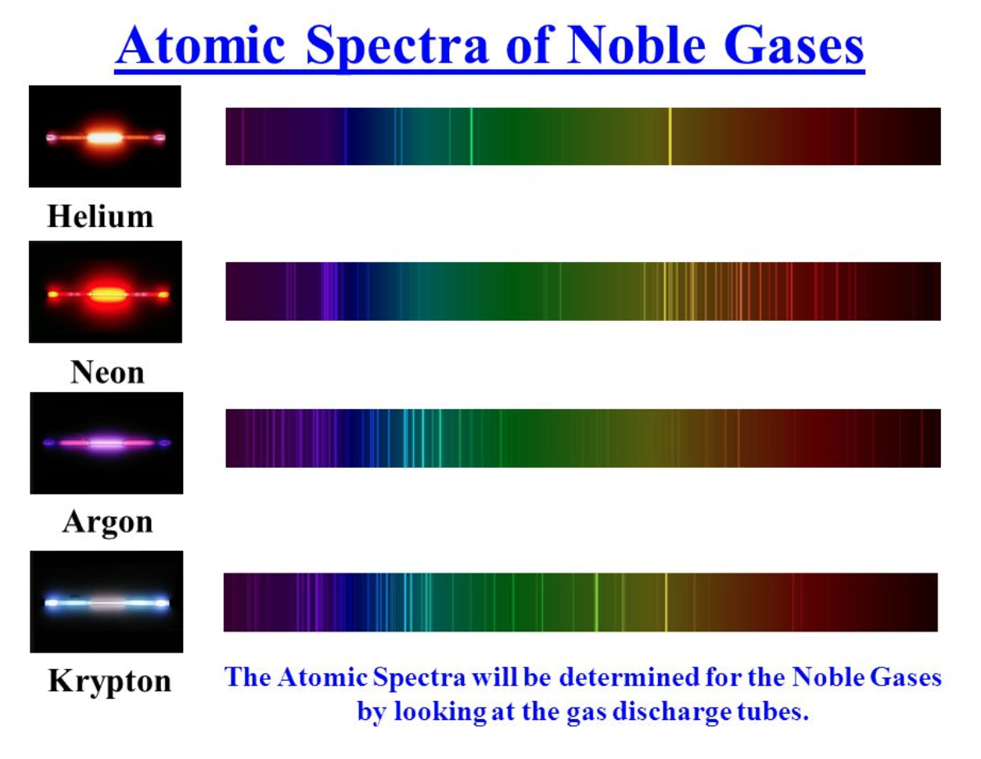
What is a absorption / emission spectrum?
Why is krypton blue and argon purple? Where do the differences in color come from?
How can these spectra help in identifying the atoms in the sun?
E.1 paper question 13

Slide 46
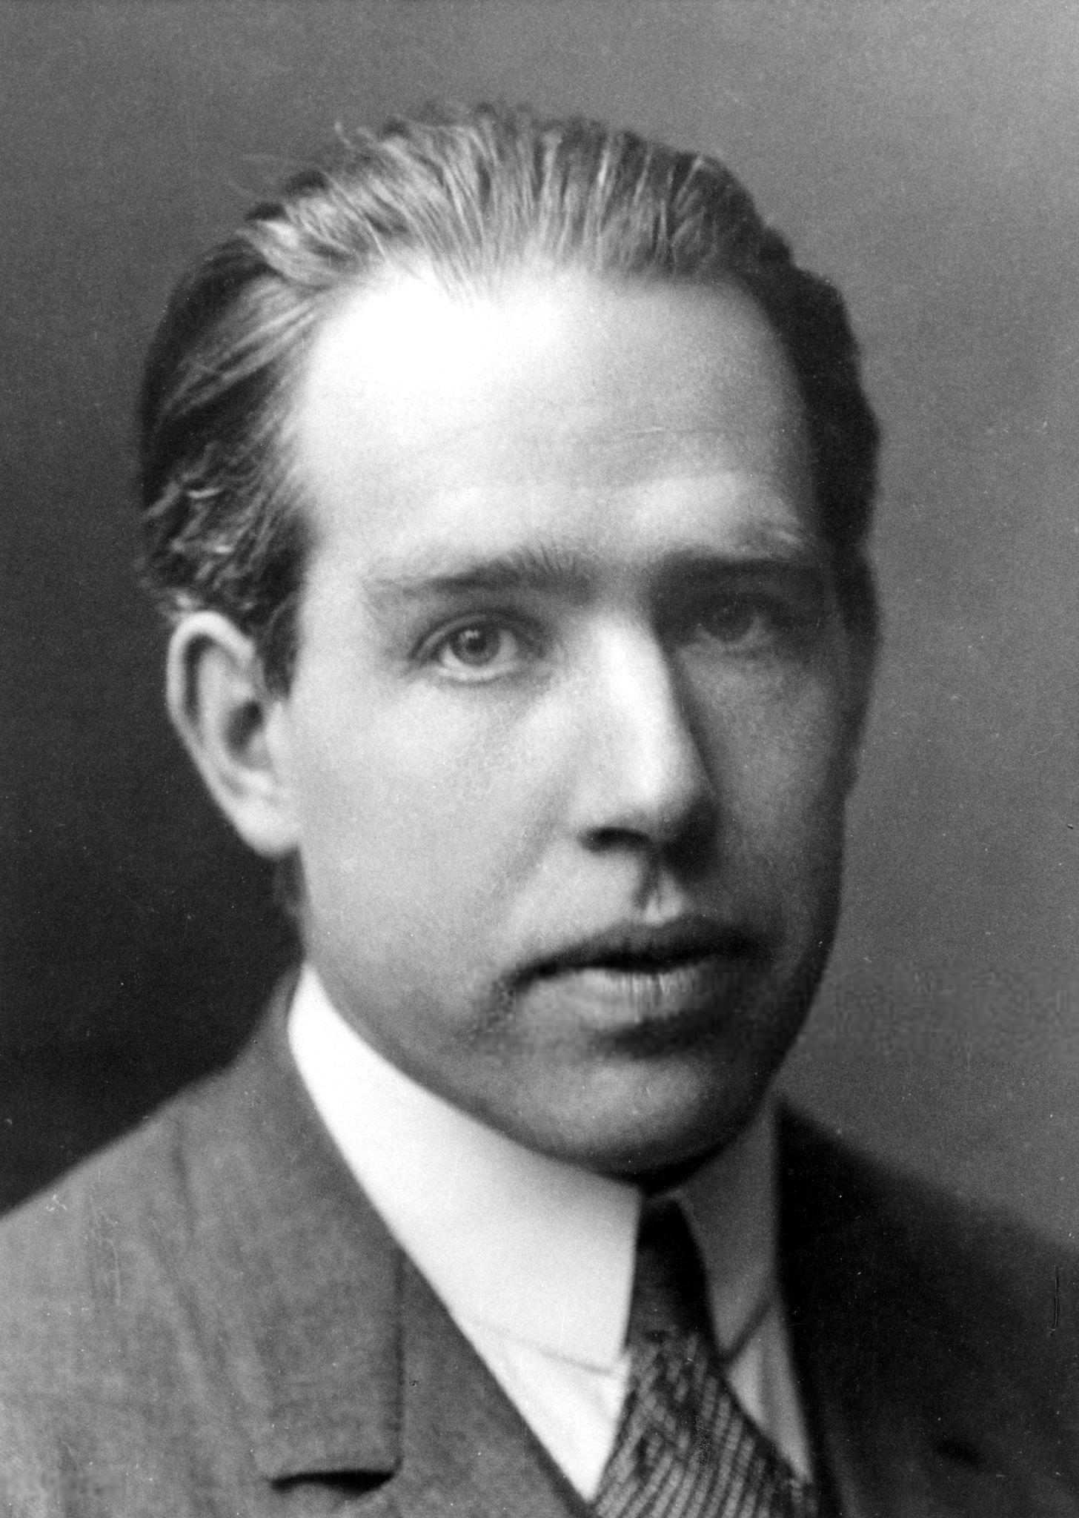
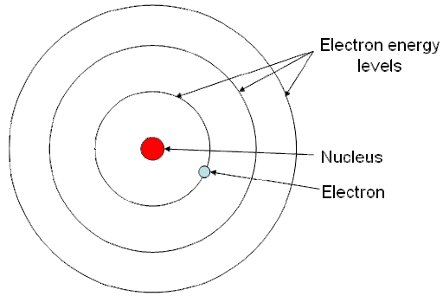
Discrete Energy Levels
Niels Bohr

Slide 47
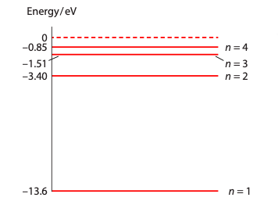
Discrete Energy Levels
Hydrogen
Niels Bohr

Slide 48
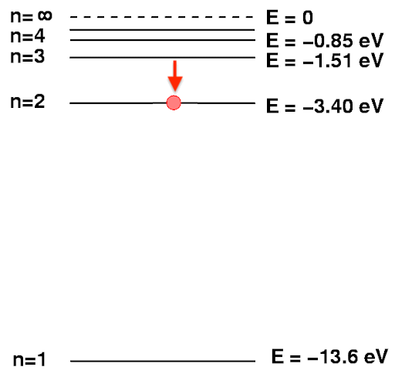
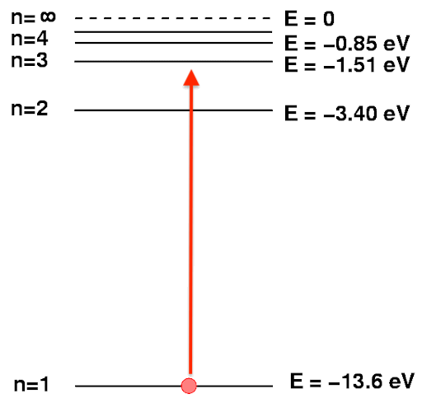
Transition to a Lower State
Transitions
Transition to a Higher State
Hydrogen

Slide 49
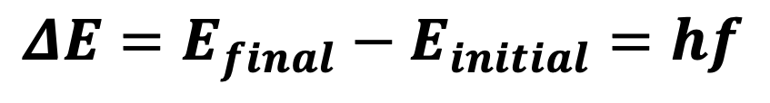
Transition to a Higher State
Hydrogen
What is h?
What is f?

Slide 51
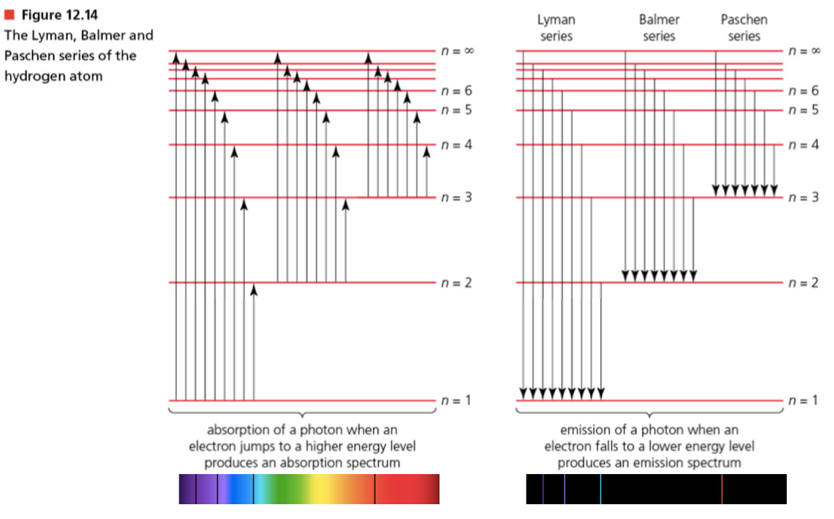

Slide 52
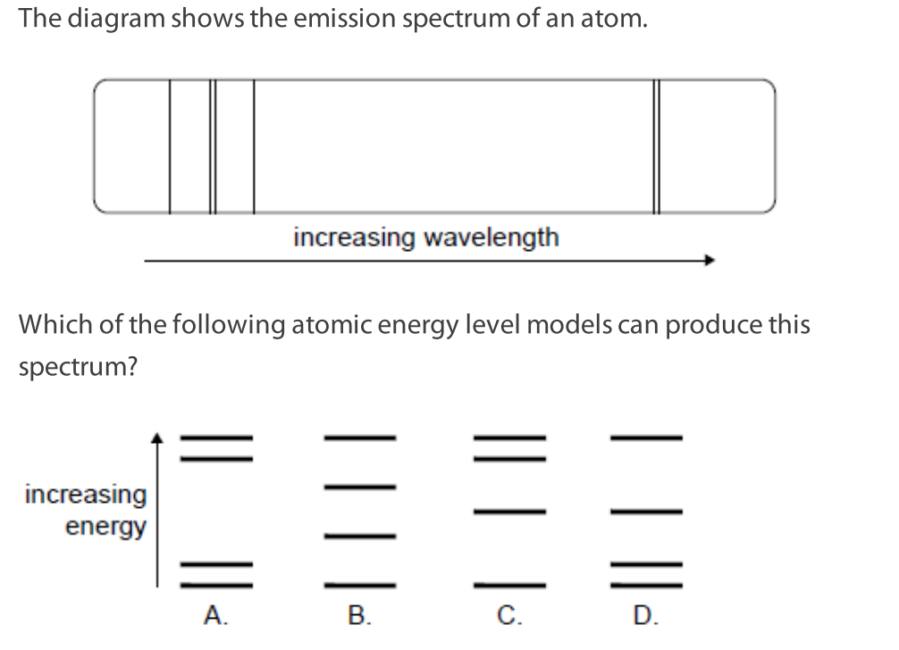
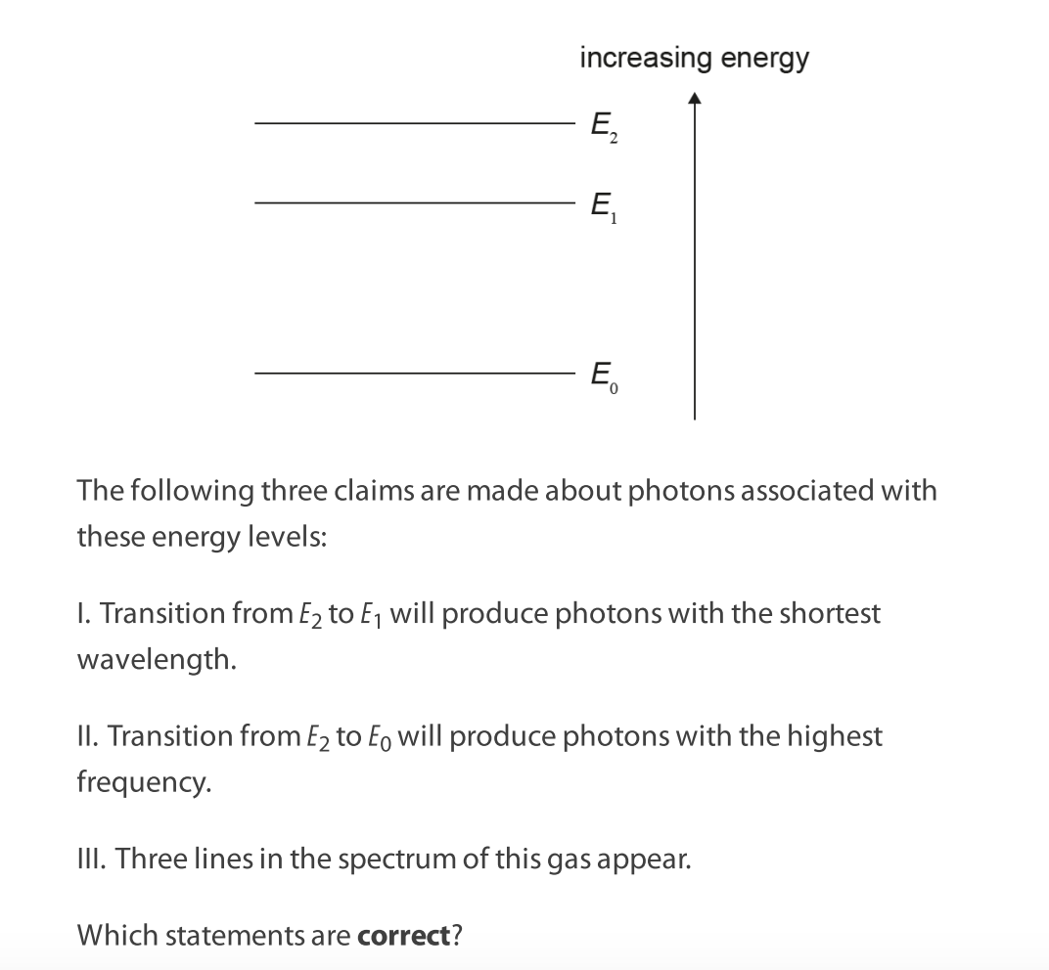
Examples
E.1 SL Paper questions: 1,2, 11, 14

Slide 53





Quantisation of Angular Momentum
Energy
Force

Slide 54
Electrons, are they particles?
How will the pattern on the screen look like for double split experiment when we shoot electrons one by one at the double slit? https://www.doubleslitexperiment.app/demo/
TOK link: What are electrons really? Are they particles?
https://www.youtube.com/watch?v=1b8eSJHMv1w

Slide 55

Energy
Force

Slide 56

Energy
Force

Slide 57

Energy
Force

Slide 58
Quantisation of Angular Momentum
Energy
Force
Do activity in E.1.2 to derive the formula for the energy of hydrogen

Slide 59



Explain why the energy levels above are negative.
Calculate the wavelength of photon with the largest wavelength possible for above energy levels.

Slide 60


E.1 HL paper questions 10 and 11
Notes:
A

Slide 61



